Slide 1

INTRODUCTION TO NON MONOTONIC REASONING LECTURE 1: BASIC ISSUES AND SOLUTIONS
Computer Science Department
University of Verona - Italy

Slide 2
COURSE STRUCTURE (1)
UNIT 1: INTRODUCTION (TODAY’S LECTURE)
The nature of non-monotonicity
Incompleteness of knowledge;
The limits of Closed World Assumption
The quest for exceptions
Clause normal form and the rule-based systems
Credulous and skeptical conclusions
Defeasible logic concept
Deontic logic and nonmonotonic reasoning extensibility

Slide 3
COURSE STRUCTURE (2)
UNIT 2: DECLARATIVE PROGRAMMING
Logic and non-monotonic reasoning as a paradigm
Logic programming – an introduction
ProLog
Answer Set Programming
Non monotonic machine learning: the Inductive Logic Programming framework
ILP problems
ILP algorithms
Effectiveness of ILP methods

Slide 4
COURSE STRUCTURE (3)
UNIT 3: MODAL LOGIC AND NON MONOTONIC PARADIGM
Labelled and modal logics
Introduction to labelled logics
Modal logics
Specific non monotonic modal structures
Epistemic logic
BDI systems (Beliefs, Desires, Intentions)
Temporal reasoning and non-monotonicity
Linear logic is non-monotonic
Representing learning and forgetting
Belief revision

Slide 5
COURSE STRUCTURE (4)
UNIT 4: APPLICATIONS
The legal reasoning framework
Argumentation
Reasoning with the law
Defeasible deontic logic
Scientific argumentation
Sustainable arguments
Scientific ground and argumentation

Slide 6
A general motivation

Slide 7
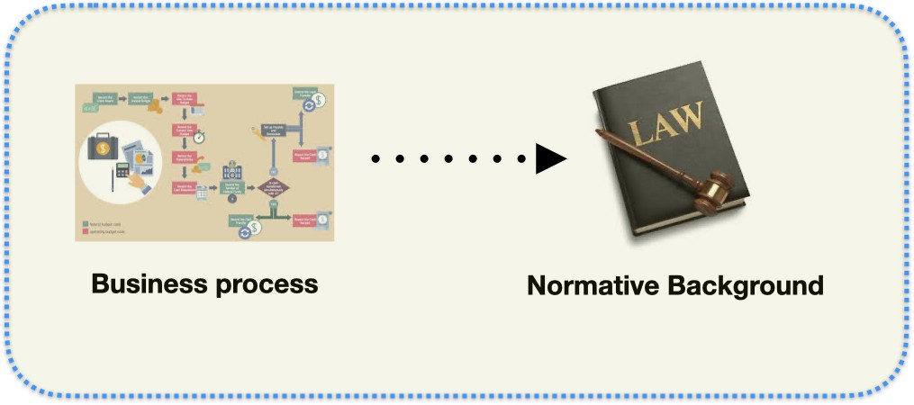
Compliance at a glance
We say that a business process is compliant against a normative background when all the obligations/prohibitions are complied with.
Regulatory compliance is globally increasing cost-wise constantly in the past three decades, since the Enrod scandal.

Slide 8
What generates the compliance needs?
Violating the Law is potentially expensive, and can cause business discontinuity.
The Law changes, therefore we need to deal with the compliance problem repeatedly.
Checking compliance is performed by experts, as it requires Knowledge of the Law and Competence in Legal Reasoning.

Slide 9
Numbers of a global issue (1)
Regulatory compliance costs represent a figure variable between 4% and 6% of the global GDP in the OECD, ad probably a higher and faster growing figure for developing countries (Thomson & Reuter 2017 Global Regulatory Compliance Report);
Number of subjects with higher qualification involved in a full-time job concerning compliance is between 10% and 16% of the global labour force with tertiary education (World Bank Labor Force annual report 2017);
Time spent in repetitive activities by the above labour force is between 50% and 70% depending on their level in the organization (Kroll Global Regulatory Outlook 2021).

Slide 10
Numbers of a global issue (2)
Decision Support Systems reduce costs of compliance of an average 15% (Data61 - CSIRO);
2020 Global GDP has been 84 trillion dollars: we can save US$152 billion dollars, that is in turn a market of a size between 50% and 60% of that value. Australia data).
The global market of compliance automation is between 76 and 91 billion dollars.
(Matteo Cristani)

Slide 11
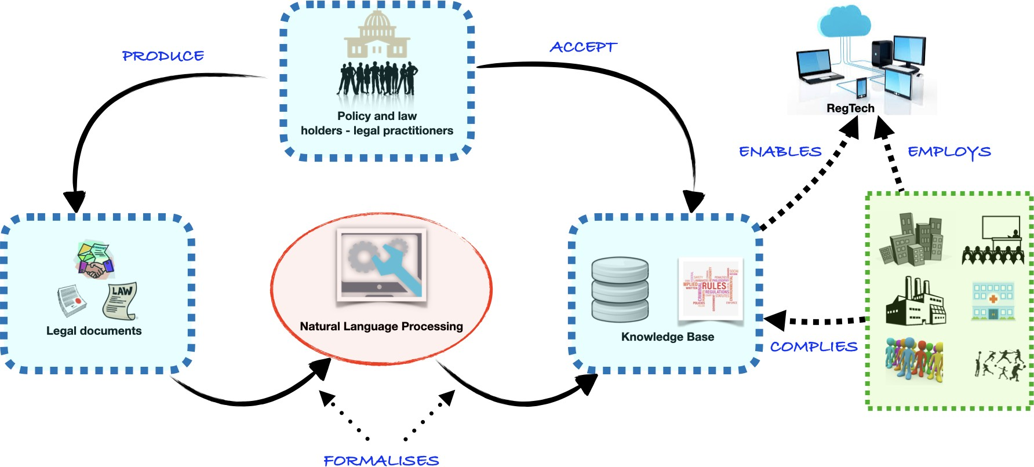
The future of a challenge: RegTech architectural schema

Slide 12
How to formalize the Law?
The Law can be viewed as a Logical Theory in which we map obligations, prohibitions and permissions.
Prohibition Exception
It is forbidden to
A case
An ambulance with
An emergency vehicle can exceed the speed limits.
exceed speed limits on a public road.
the blue lights is an ermegency vehicle

Slide 13
What is RegTech?
RegTech aims at automating some of the processes involving the above purposes.
Prohibition Exception
It is forbidden to
A case
An ambulance with
An emergency vehicle can exceed the speed limits.
exceed speed limits on a public road.
blue lights on is an ermegency vehicle.
d (x, y ), r (y, z ) ⇒
O[S (y ) ≤ L(z )]
d (x, y ), e(x ), v (y ) ⇒
a(x ), b(x ) →
P[S (y ), L(z )]
e(x )

Slide 14
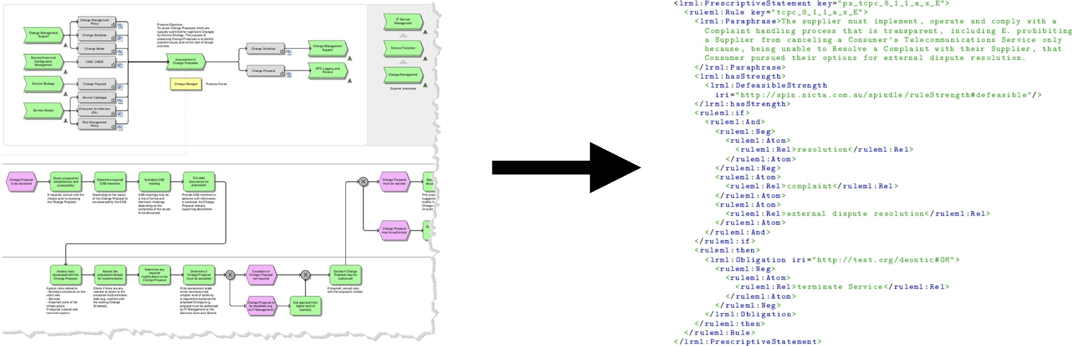
The Business Process Compliance problem
Given a Workflow representing the business process of a company, determine whether this is compliant against a legislation in a jurisdiction.
The Declarative approach
Transform the business process into a declarative formalism and compare it against the (formalised) legal background.

Slide 15
Regulatory compliance: declarative frameworks
Deontic
We need to encode
Defeasible
Linear
We need to manage
Typical conclusions;
Exceptions.
We need to incorporate
Consumable; General literals.
Obligations, Prohibitions and Permissions.
(Temporal) Defeasible Deontic Linear Logic

Slide 16
Evolving the Montague Semantics in Temporal Linear Deontic Defeasible Logic
Current Montague’s Semantics
Evolution - what do we need to add?
A sentence is a FOL
formula;
Nouns are lambda-terms, or unary predicates;
Articles are quantifiers.
Modals;
Consumable quantities; Expressions of exceptions; Time.

Slide 17
The role of machine learning in RegTech: opportunities and risks
Opportunities
Relevance (context, applicability); Novelty;
Provenance.
Risks
It is not possible to make use of large datasets for new laws.

Slide 18
INCOMPLETENESS OF KNOWLEDGE
“All models are wrong, but some are useful” — George Box
Describing the reality in a complete fashion is impossible;
Nature of generalisations;
Potentials of deductive systems.

Slide 19
INTRINSIC NATURE OF MODELISATION
A model of the reality is stratified as a way to represent reality:
Physical models: description of the interactions among objects viewed as governed by physical laws;
Conceptual models: description of the relations among objects that introduce also asserted relations that might have no physical origins;
Mental models: internal representation of the worlds’ relations.

Slide 20
STRATIFIED EXAMPLE
Consider the reality of
Students attend the lecture

Slide 21
PHYSICAL MODEL
Physical modelisation can identify a set of bodies, a space, and several interactions of geometric, mechanic, chemical, electric nature.

Slide 22
CPNCEPTUAL MODEL
Students may be related to the teacher by the relation listen that has an arguable physical nature
Also student can be viewed as attending the lecture (the very description at top level of the scene)
We can introduce a concept of content

Slide 23
MENTAL MODELS
In 1943, the scottish Philosopher Kenneth Craik published The nature of explanation
The book discusses the ways in which humans provide reason to argue a conclusion
The concepts expressed by Craik have been controversial

Slide 24
THE ARGUMENTATION BATTLE
The 1950s have been, in the philosophy community, a moment of struggle
Forensic rethoric, psychology, philosophy of language meet at the crossroads of a spectacular issue: how people provide a motivation for their thoughts

Slide 25
THE TREMENDOUS BIAS OF THE INARGUABLE
The period between the two wars has provoked a strong shift in the very notion of arguability
Traditional idea was contained in the freedom of speech theoretical notion that, while following Voltaire’s mantra assumed that anything that is arguable is controversial

Slide 26
IS THIS ARGUABLE?
Are the assertions of Hitler arguable?
The accepted conception in the philosophy of language, rethoric and other scientific contexts is that Hitler’s argument are inarguable
They are uncontroversially absurd
Nonetheless, can we say that they are false? Or should we say that they are wrong? Is this anyway different?
Has asserting their falsity the same nature of asserting their inarguability?

Slide 27
TARSKI’S ARGUMENTATION CONCEPT
The dicothomy true/untrue is typical of mathematics and possibly of empirical observations
The dicothomy arguable/unarguable is intrinsically out of the debate in Logic when we start with Voltaire’s viewpoint
Tarski introduces the idea that a good argument follows a rule of truth
Tarski’view is a modern version of Aristotle’s notions

Slide 28
ARGUABILITY, REPRESENTABILITY AND THE LIKE
Arguable: that can be justified by a rule of truth that the discussants agree to hold, on the discussion context;
Grounded: that has a form of empirical, uncontroversial original nature;
Hypotetical: that is neither proven by acceptable arguments not disproven;
True: that can be proven by a set of acceptable rules of truth in a way that makes the argument in its favour unquestionable.

Slide 29
THE CLOSED WORLD ASSUMPTION
The Closed World Assumption (CWA) is the assumption that what is not known to be true, is false;
Absence of information is interpreted as negative information.

Slide 30
EXAMPLES OF OPEN WORLDS (1)
Temporal extensions
You wear Armani suits [SOMETIMES] VS
You do not wear Armani suits [NEVER]

Slide 31
THE MITIGATORS
Usually, typically, generally.
I usually do not drink coffee after 9 pm, but tonight I am sleepy and I need to work until midnight because I promised to my PhD advisor I finish preparing the related work section.

Slide 32
THE FRAME PROBLEM
The FP is one of the problems that have provoked the birth of symbolic AI and it is maintained as basic for the very notion of reasoning with Open Worlds

Slide 33
FORMULATION OF THE FRAME PROBLEM
In First Order Logic, we represent two predicates On and Open that depend on time;
We allow constants 0,1, 2…;
In the further definitions we name the assertions of ground formulae fluents.

Slide 34
EXAMPLE
Consider the following initial configuration:
NOT OPEN(0)
NOT ON(0)
That identifies the first frame where the light is off and the door is closed

Slide 35
EXAMPLE
Now let us consider the subsequent frame
OPEN(1)
NOT ON(1)
This is consistent with the previous frame, but…

Slide 36
EXAMPLE
Also consistently with the first frame, we have
NOT OPEN(1)
ON(1)

Slide 37
EXAMPLE
Now, the question is: do we have an explanation for the existence of the second scenario?
Allow frame transformations to act:
DOOR-OPEN()
TURN-LIGHT()

Slide 38
EXAMPLE
For the first scenario we can imagine
Someone entered the room
To guarantee that a miracoulous turning on of the light does not occur we need to introduce frame axioms for instance
ON(0) ⇔ ON(1)

Slide 39
MISSIONARIES AND CANNIBALS
In the missionaries and cannibals problem, three missionaries and three cannibals must cross a river using a boat which can carry at most two people, under the constraint that, for both banks, if there are missionaries present on the bank, they cannot be outnumbered by cannibals (if they were, the cannibals would eat the missionaries). The boat cannot cross the river by itself with no people on board.

Slide 40

NICE PICTURE!

Slide 41
SOLUTION
Trip number | Starting bank | Travel | Ending bank
(start) | αa βb γc
1 | βb γc | αa →
2 | βb γc | ←α | a
3 | α β γ | bc → | a
4 | α β γ | ← a | b c
5 | αa | βγ → | b c
6 | αa | ← βb | γc
7 | a b | αβ → | γc
8 | a b | ← c | α β γ
9 | b | a c → | α β γ
10 | b | ← β | αa γc
11 |  | βb → | αa γc
(finish) |  |  | αa βb γc

Slide 42
CIRCUMSCRIPTION LOGIC
The principle of circumscription is: what is not needed to be true, is assumed false
The concept is expressed in terms of minimal models

Slide 43

EXAMPLE OF MINIMAL MODELS
Consider the formula
$a∧(b ∨c)$
It has three models:
{a,b,c}
{a,b,-c}
{a,-b,c}
Non minimal
Minimal

Slide 44
CIRCUMSCRIPTION FAILURE
The attempt to solve the frame problem by circumscription failed
John McCarthy tried several interesting variants of the CL, but none was able to solve the FP, nor to identify correctly methods for solving the M&C or the Yale Shooting Problem

Slide 45
THE NATURE OF GENERALIZATIONS
Consider the Yale Shooting Problem as described by fluents
Fred (a turkey) is alive; a gun is unloaded.
Loading the gun, waiting, and then shooting at Fred is expected to kill Fred.
Minimal models of fluents do not work for the YSP

Slide 46
STRUCTURE OF THE FRAME
INITIAL STATE
alive(0)
-loaded(0)
EVOLUTION
true -> loaded(1)
loaded(2) -> -alive(3)
MINIMAL INTERPRETATION 1
loaded(1); loaded(2); -alive(3)
MINIMAL INTERPRETATION 2
loaded(1); -loaded(2); alive(3)

Slide 47
TEMPORAL REASONING ISSUES
It became clear that we needed a way to represent evolution of the world, and logicians started to interpret this in terms of nature of the logical framework
At first, many logicians tried to model, in different ways, the fact that assertions made by humans represent different categories

Slide 48
A TYPOLOGY OF CLAIMS
Invariants: assertions whose nature is independent of the time flow
Temporal claims: assertions whose nature refers explicitely time
Fluents: assertions whose meaning depends on time

Slide 49
EXAMPLES
The area of the square whose side is the hypotenuse is equal to the sum of the areas of the squares on the catethi;
Trump did not show up on 20/01/2021
You are wearing a very nice hat!

Slide 50
THE QUEST FOR EXCEPTIONS
Monotonicity is the property of a logical system that derives a formula iff it concludes it;
Modal operators connect non monotonic frameworks towards monotonic ones.

Slide 51
TEMPORAL MODALITIES
Consider the sentence
John is married
Compare it with the following cases
John is not anymore married
John has been married for a while
John was married since 1/7/2000 to 21/3/2020 when he divorced

Slide 52
SPATIAL MODALITIES
Here you drive on the right
Here you drive on the left
The speed limit is 25 mph in the urban areas
La velocità consentita nei centri urbani è 50 km/h

Slide 53
EPISTEMOLOGICAL MODALITIES
John does not understand mathematics
Frank knows John very well
Andrew claims to be originally Hungarian

Slide 54
THE COMMON NATURE OF MODALITIES
Modal logics model the variability of semantics
To identify the common trait in those models, logicians invented the term exceptions
An exception is the violation of a rule

Slide 55
THE COMMON NATURE OF MODALITIES
Therefore, when something is not an absolute truth, when it is not true everywhere, in every moment, for everyone, and so on…it is true in specific cases
When a truth is general but not universal, has got exceptions

Slide 56
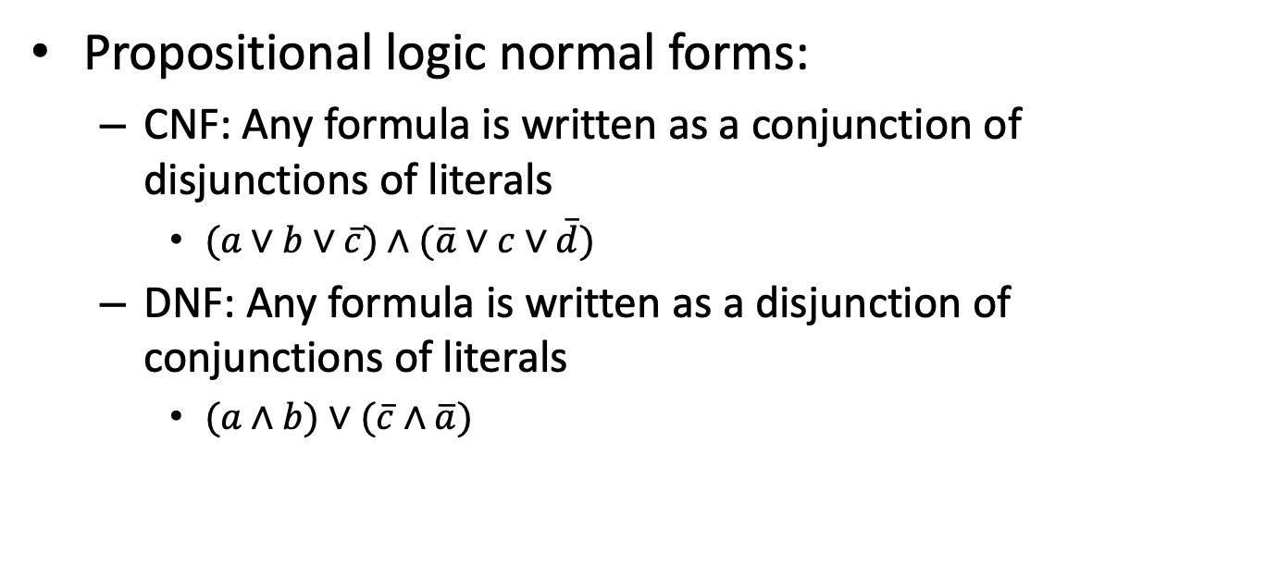
RULE-BASED SYSTEMS
Propositional logic normal forms:
CNF: Any formula is written as a conjunction of disjunctions of literals
$(a∨b∨\overline{c})∧$ $(\overline{a}∨c∨\overline{d})$
DNF: Any formula is written as a disjunction of conjunctions of literals
$(a∧b)∨(\overline{c}∧\overline{a})$

Slide 57
ELEMENTARY FORMULAE
Elementary formulae are those formed by conjunctions of literals (elementary conjunctive formulae) or disjunctions of literals (elementary disjunctive formulae)

Slide 58
BASIC CLAUSES
Any disjunctive elementary formula admits a basic clausal form, obtained by choosing ONE literal (the head), while the other literals form the tail, and it is written as the implication of the conjunctive elementary formula formed by all the literals generated by negating the elements not chosen as head towrds the head

Slide 59
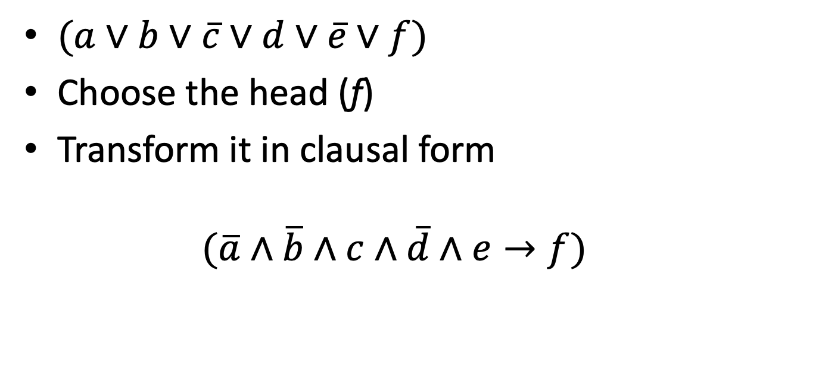
REDUCTION TO CLAUSE
$(a∨b∨\overline{c}∨d∨\overline{e}∨f)$
Choose the head (f)
Transform it in clausal form
$$(\overline{a}∧\overline{b}∧c∧\overline{d}∧e→f)$$

Slide 60
CLAUSAL FORM
For every formula, we can reduce it to its clausal form, by firstly reducing it to its CNF, and then devising the conversion in ClaNF
Obviously, it can make the difference what head we choose on its single elementary clause

Slide 61
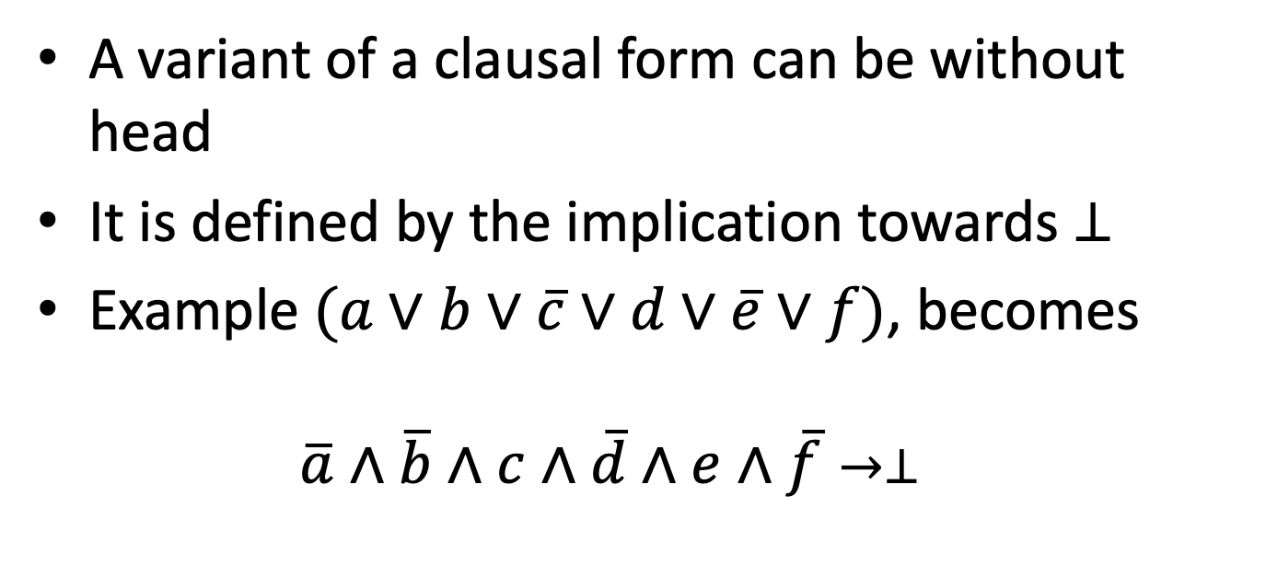
BEHEADED CLAUSES
A variant of a clausal form can be without head
It is defined by the implication towards $⊥$
Example $(a∨b∨\overline{c}∨d∨\overline{e}∨f)$, becomes
$$\overline{a}∧\overline{b}∧c∧\overline{d}∧e∧\overline{f}→⊥$$

Slide 62
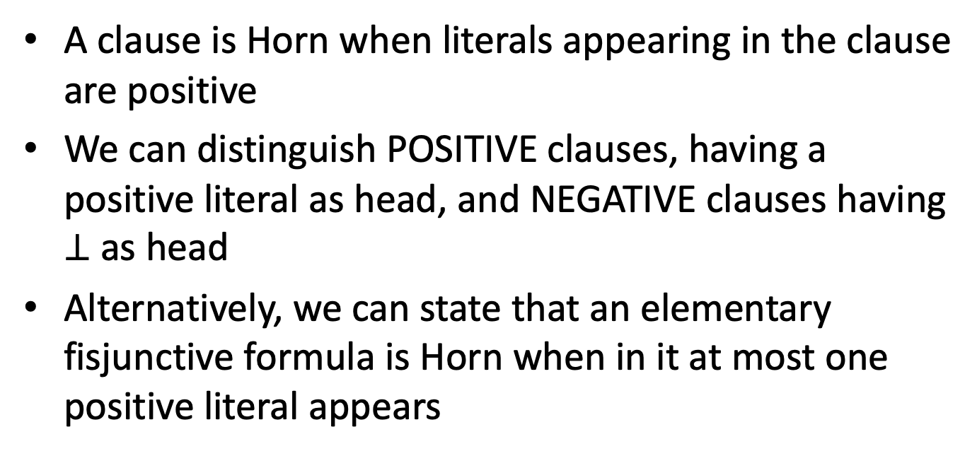
HORN CLAUSES
A clause is Horn when literals appearing in the clause are positive
We can distinguish POSITIVE clauses, having a positive literal as head, and NEGATIVE clauses having $⊥$ as head
Alternatively, we can state that an elementary fisjunctive formula is Horn when in it at most one positive literal appears

Slide 63

EXAMPLE
$$\left(\overline{a}∨\overline{b}∨\overline{c}∨d∨\overline{e}∨\overline{f}\right)$$
$$(a∧b∧c∧e∧f→d)$$
$$\left(\overline{b}∨\overline{c}∨\overline{f}∨\overline{g}\right)$$
$$(b∧c∧f∧g→⊥)$$

Slide 64
RULE NOTATION
We shall introduce here a notation for clauses known as rule form
Tails of rules are written in form of sequences of literals separated by commas

Slide 65
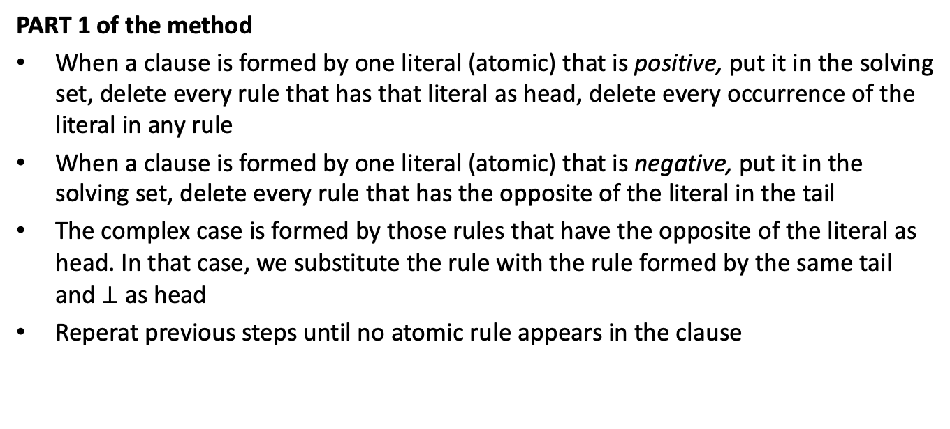
SOLVING HORN CLAUSES (1)
PART 1 of the method
When a clause is formed by one literal (atomic) that is positive, put it in the solving set, delete every rule that has that literal as head, delete every occurrence of the literal in any rule
When a clause is formed by one literal (atomic) that is negative, put it in the solving set, delete every rule that has the opposite of the literal in the tail
The complex case is formed by those rules that have the opposite of the literal as head. In that case, we substitute the rule with the rule formed by the same tail and $⊥$ as head
Reperat previous steps until no atomic rule appears in the clause

Slide 66
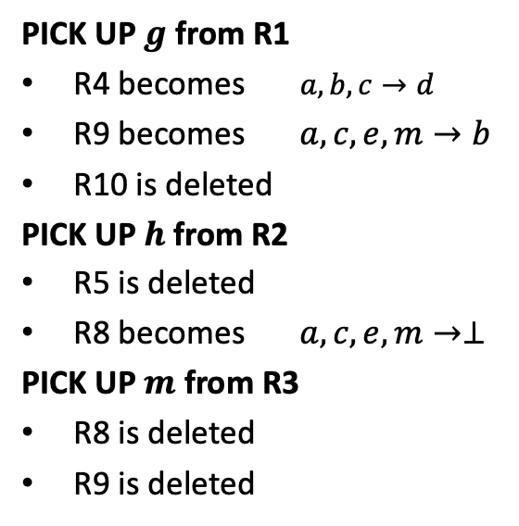
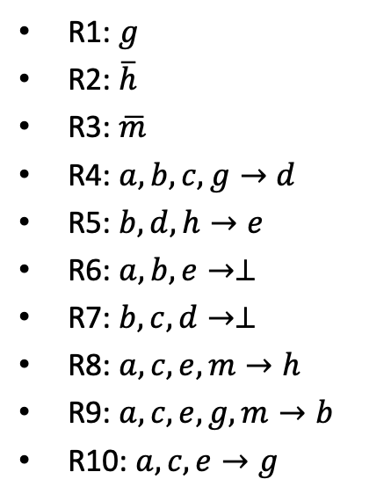

EXAMPLE
R1: $g$
R2: $\overline{h}$
R3: $\overline{m}$
R4: $a,b,c,g→d$
R5: $b,d,h→e$
R6: $a,b,e→⊥$
R7: $b,c,d→⊥$
R8: $a,c,e,m→h$
R9: $a,c,e,g,m→b$
R10: $a,c,e→g$
PICK UP $g$ from R1
R4 becomes $a,b,c→d$
R9 becomes $a,c,e,m→b$
R10 is deleted
PICK UP $h$ from R2
R5 is deleted
R8 becomes $a,c,e,m→⊥$
PICK UP $m$ from R3
R8 is deleted
R9 is deleted
SOLVING SET
$g,\overline{h}$, $\overline{m}$

Slide 67
SOLVING HORN CLAUSES (2)
PART 2 of the method
Pick the positive literals at the head of a clause
Add an atomic clause with the positive literal
Repeat PART 1 and PART 2 until no clauses with positive head exist

Slide 68


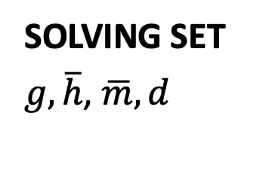
EXAMPLE
R4: $a,b,c→d$
R6: $a,b,e→⊥$
R7: $b,c,d→⊥$
PICK UP d in R1
R7 becomes $b,c→⊥$
SOLVING SET
$g,\overline{h}$, $\overline{m},d$

Slide 69
SOLVING HORN CLAUSES (3)
PART 3 of the method
Pick up a literal in a formula, choosing the first one that does not occur in the current solving set
When for a given formula, no literal exist that satisfies the above, there is no solution
Repeat until all formulas have been passed or one has failed to fill the solving set

Slide 70


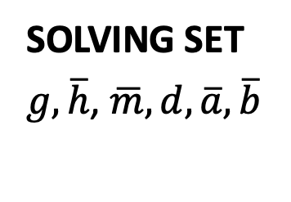
EXAMPLE
R6: $a,b,e→⊥$
R7: $b,c→⊥$
PICK UP $a$ in R6
PICK UP $b$ in R7
SOLVING SET
$g,\overline{h}$, $\overline{m},d,\overline{a},\overline{b}$

Slide 71
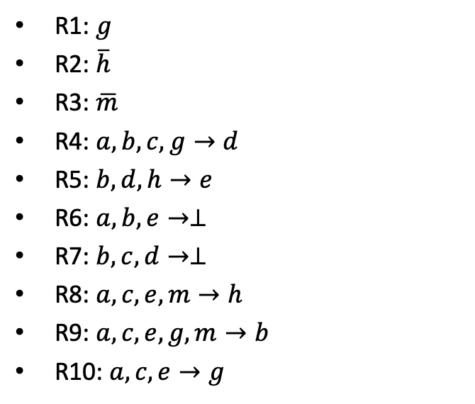
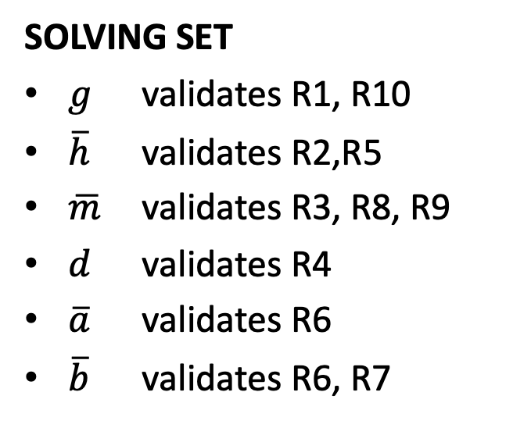
VALIDATION
R1: $g$
R2: $\overline{h}$
R3: $\overline{m}$
R4: $a,b,c,g→d$
R5: $b,d,h→e$
R6: $a,b,e→⊥$
R7: $b,c,d→⊥$
R8: $a,c,e,m→h$
R9: $a,c,e,g,m→b$
R10: $a,c,e→g$
SOLVING SET
$g$ validates R1, R10
$\overline{h}$ validates R2,R5
$\overline{m}$ validates R3, R8, R9
$d$ validates R4
$\overline{a}$ validates R6
$\overline{b}$ validates R6, R7

Slide 72
DEFAULT LOGIC
The basic mechanism of default logic is twofold
Every assertion has a primary meaning (the default) and secondary meanings (the exceptions)
Assertions are made, but can be withdrawn when an exception occurs

Slide 73
EXAMPLE OF DEFAULT MECHANISM
Birds fly
Tweety is a penguin
Penguins are birds
HOWEVER
Penguins don’t fly
PREFERENTIAL CONCLUSION:
Tweety does’nt fly

Slide 74
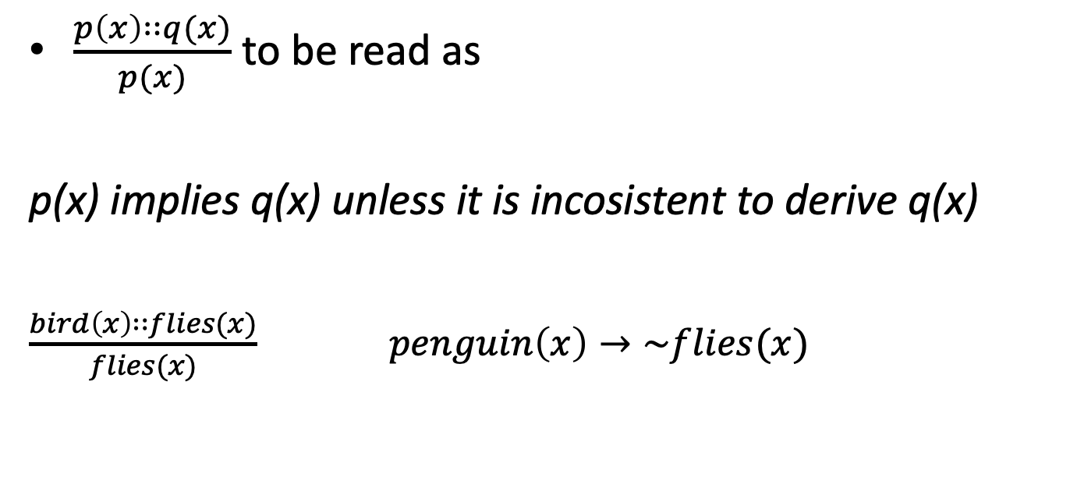
DEFAULT LOGIC STRUCTURE
$\frac{p\left(x\right)∷q(x)}{p(x)}$ to be read as
p(x) implies q(x) unless it is incosistent to derive q(x)
$\frac{bird\left(x\right)∷flies(x)}{flies(x)}$ $penguin\left(x\right)→\sim flies(x)$

Slide 75
MINIMAL MODELS
Minimal models (as proposed by McCarthy for Circumscription Logic) apply to Default Logic as well
A model is minimal if it contains ONLY the non-default assertions
To obtain an extension of a minimal model we add one single assertion derived by a default at a time

Slide 76
FIXPOINT SEMANTICS
Apply extension operator to a minimal model repeatedly until no more extension can be computed
Establish a preference relation among the fixpoint models by a partial order

Slide 77
FIRST ORDER OR MODALITIES?
Clearly, the above approach is the base for extending the modal logic approach to non monotonic systems

Slide 78
CONCLUSIVITY
If we need preferences this means that we cannot draw conclusions, when derivation is admitted
Fixpoint extensions of default logics can be taken as granted in two distint ways:
When a single claim is derived in every fixpoint model, then that claim is concluded
When a single claim is derived in at least one fixpoint model, then the claim is concluded

Slide 79
THE NUTE’S PROPOSAL
Donald Nute argued, in his milestone study of 1987 «Defeasible reasoning» that since actual derivations in Default Logic are purely propositional and indeed, it makes no sense to consider the expections alternative rules for they are subject to the same model, we could have quit to the FOL level and start all over again with a Propositional Calculus Model
The Defeasible Logic agenda started there

Slide 80
RUNNING ON THE QUEST FOR EXCEPTIONS
Consider the propositional framework and assume that we know that a certain predicate, for instance fly cannot be generalised over another predicate bird
In fact, what we know, is that certain categories of birds do not fly
Potentially, however, it could also be the case that certain subcategories of non-flying birds fly or that a specific supersmart individual in turn flies

Slide 81
THE COMBINATORICS OF EXCEPTIONS
When the number of nested exceptions arise, we reveal another aspect of the intrinsic nature of rule-with-exception model that is very common in natural language
Writing a rule with multiple nested multilevel exceptions is much easier than writing the actual subrules

Slide 82
EXAMPLE OF COMBINATORICS
Let us consider the mass-acceleration laws and its consequences
In general, we can assume that classical physics is false, as it does not hold for high speed phenomena and also for microscopic and microscopic scales where we should consider, respectively, the quantum model and the Fermi-Dirac standard interpretation

Slide 83
ANALYTICS
N (Newton’s Physics)
F (Fermi-Dirac standard interpretation, also known as Standard Model
or Quantum-Relativistic Physics)
Q (Quantum Physics)
G (General Relativity)
S (Special Relativity)
H (High-Speed)
T (microscopic level)
W (macroscopic level)

Slide 84
LOGIC REPRESENTATION
If we get onto rules, we should make specific staments on the single conditionals, in order to guarantee the correct application of the specific physics

Slide 85
A RATHER COMPLEX MODELIZATION
We have 8 possible physical contexts of which two are absurd
The specific physics model hold on the specific context
H | T | W | MODEL
X | X |  | F
X |  | X | F
X |  |  | S
 | X |  | Q
 |  | X | G
 |  |  | N

Slide 86

EXPRESSING VARIETIES OF PHYSICS
We can represent them by rules
$$H,T,\overline{W}→F$$
$$H,\overline{T}, W→F$$
$$H,\overline{T},\overline{W}→S$$
$$\overline{H},T,\overline{W}→Q$$
$$\overline{H},\overline{T}, W→G$$
$$\overline{H},\overline{T},\overline{W}→N$$

Slide 87

OR…BY RULES WITH EXCEPTIONS
R1: $H →F$
R2: $\overline{T},\overline{W}→N$
R3: $\overline{H}→Q$
R4: $\overline{T},\overline{H}→G$
R5: $\overline{W},\overline{H}→G$
R6: $W,T$ $→⊥$

Slide 88
REPRESENTING THE STRUCTURE OF EXCEPTIONS
Defeasible logic responds to the quest for exceptions by avoiding combinatorics
The basic notion is the one of defeasible rule

Slide 89
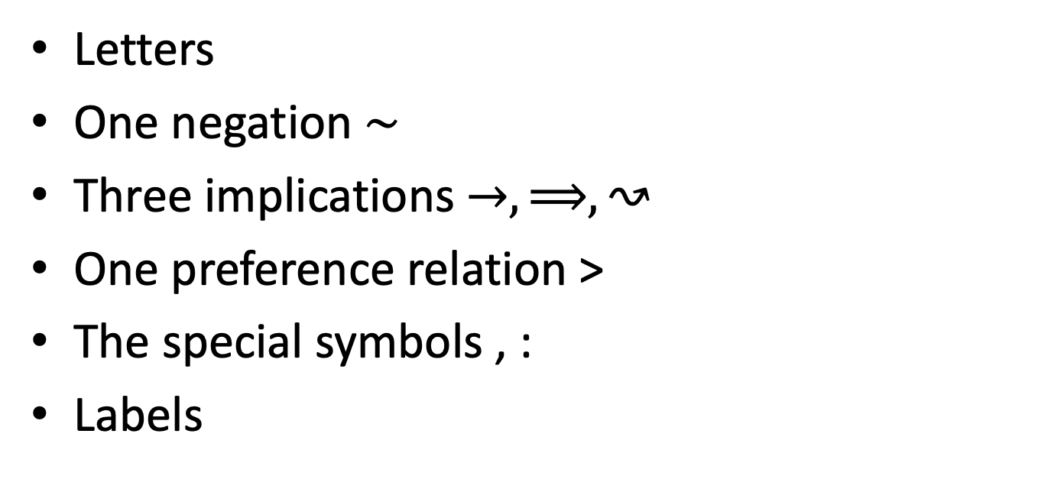
DEFEASIBLE LOGIC PARAPHERNALIA
Letters
One negation $∼$
Three implications $→,⟹,↝$
One preference relation >
The special symbols , :
Labels

Slide 90
FACTS AND RULES
Facts are literals
Rules are formed as one label upon an implication between a set of literals, separated by commas and one literal
Preferences are applied between two rules with opposite conclusions
A set of rules, facts, and prefences is named a defeasible theory

Slide 91
READY FOR NEXT STEP?
We are now leaving you in a reflexion state, when thinking back on all these things and preserve them on your heart
For the next lecture, when we shall introduce the real issue of the solution for non monotonic problems: scepticisim, the attitude that will give us the light at the end of the tunnel
Hoping it won’t be the train gettin’ in

